Slide 1
MLA Style
Guidelines for citation and formatting
Notes:
These lecture slides are based on Scribbr’s “A complete guide to MLA style” article, which can be found here: https://www.scribbr.com/category/mla/
How to edit this presentation:
Click on ‘File’ in the top-left corner.
Click on ‘Make a copy’
Select ‘Entire presentation’
Save the presentation in your personal Google Drive.
You can now edit the copy of this presentation!

Slide 2

What is MLA Style?
MLA = Modern Language Association
Citation style used in the humanities
Handbook currently in its 9th edition
Notes:
MLA stands for the Modern Language Association, an organization for scholars of language and literature.
MLA publishes its own style guide, the MLA Handbook. It contains guidance on research and writing, and especially on citing sources.
The newest edition of the MLA Handbook, the 9th, was published in 2021, with the previous edition, the 8th, appearing in 2016.

Slide 3
MLA in-text citations
Notes:
To cite sources in MLA, you need an in-text citation whenever you quote or paraphrase a source, and a corresponding Works Cited entry for each source.
Let’s first take a look at your in-text citations. These are short citations that point the reader to the relevant entry in the Works Cited list.
Audience question: Does anyone know what two elements an MLA in-text citation includes?
“MLA in-text citations” article: https://www.scribbr.com/mla/in-text-citations/

Slide 4
In-text citation format
Parenthetical citation
One critic convincingly argues that Frankenstein’s horror at the monster’s appearance mirrors the reader’s horrified reaction to the novel itself (Cottom 60).
Narrative citation
Cottom (60) argues that the monster can be taken to represent the novel itself, Frankenstein’s horror upon seeing him mirroring the reader’s own horror.
Notes:
In-text citations consist of the author’s last name and the page number of the relevant information.
An in-text citation is included every time you quote or paraphrase a source. In the examples above, the information from the source is paraphrased—put into your own words.
You can see from these examples that there are two ways of incorporating a citation: parenthetical and narrative.
With a parenthetical citation, you put both elements inside the parentheses, usually at the end of the clause or sentence.
With a narrative citation, the author’s name is incorporated into the structure of your sentence, with only the page number in parentheses.

Slide 5
Quoting
Frankenstein’s description of the monster emphasizes his grotesque appearance: his “watery eyes . . . seemed almost of the same colour as the dun white sockets in which they were set” (Shelley 39).
Notes:
When you quote a source directly, the quoted text is placed in quotation marks, and should be introduced or incorporated into the sentence, not just placed in the text without context.
You can use ellipses to shorten a quote where necessary, to save space, remove irrelevant text, or better incorporate the quote into your sentence.
Here, the word “that” is replaced with an ellipsis so that the quote makes grammatical sense in the context of the sentence.
A citation appears after the quote, outside the quotation marks but before the period (or comma, or whatever punctuation follows the quote in the sentence).
“How to quote” article: https://www.scribbr.com/citing-sources/how-to-quote/

Slide 6
Block quoting
The monster’s grotesque appearance is emphasized:
His yellow skin scarcely covered the work of arteries beneath; his hair was of a lustrous black, and flowing; his teeth of a pearly whiteness; but these luxuriances only formed a more horrid contrast with his watery eyes, that seemed almost of the same colour as the dun white sockets in which they were set, his shrivelled complexion, and straight black lips. (Shelley 39)
Notes:
When you quote more than four lines of prose, you should format the quotation as a block quote.
A block quote is not enclosed in quotation marks. Instead, it’s indented to set it apart from the rest of the text.
The citation for a block quote, unlike that for a normal quote, appears after the period (or other punctuation mark) that concludes the quotation.
Use long quotations sparingly; unless you plan to analyze this quotation in depth, it may be better to quote it in the shortened form shown in the previous slide.
“Block quoting” article: https://www.scribbr.com/mla/block-quotes/

Slide 7
Multiple authors
 | Parenthetical citation | Narrative citation
1 author | (Smith 15) | Smith (15)
2 authors | (Smith and Jones 211) | Smith and Jones (211)
3+ authors | (Smith et al. 65) | Smith and colleagues (65)
Notes:
What if a source has multiple authors? Just like in the Works Cited list, list both names if there are two.
If there are three or more authors, just list the first, followed by “et al.” in a parenthetical citation or a phrase like “and colleagues” or “and others” in a narrative citation.

Slide 8
Combining citations
(Smith 15) (Jones 23) (McCombes et al. 38)
(Smith 15; Jones 23; McCombes et al. 38)
Notes:
When several citations are needed in the same place—for example, in a sentence that summarizes multiple sources—combine the different citations in one set of parentheses, separated by semicolons.

Slide 9

Notes:
Though the in-text citation format is straightforward, there are a few exceptions to take into account.
This video gives tips on what to do when you don’t have an author or page number for your source; how to handle multiple works with the same author name; and how to cite a source you found quoted in another source.

Slide 10
MLA Works Cited
Notes:
Now, let’s look at the Works Cited list. It appears at the end of your paper and provides complete information on all the sources you cite.
Because of this, Works Cited entries are trickier to format than in-text citations, but it’s important to get them right.
“MLA Works Cited” article: https://www.scribbr.com/mla/works-cited/

Slide 11
The 9 core elements
Author
Source title
Container title (if the source is part of a larger whole)
Other contributors (e.g. editors, translators)
Version (if there are different editions)
Number (if there are multiple volumes/issues)
Publisher (for books and movies)
Publication date
Location
Notes:
This list shows the nine core elements of an MLA Works Cited entry, in the order they appear in the entry.
Using this template, you can build an MLA citation for any type of source.
Not every element will be relevant in each case; it’s rare for an entry to include all nine elements.
Instead, determine which of the elements are relevant to your source, and include them in this order, skipping the ones that don’t apply.
Let’s go through the different elements in turn.

Slide 12
The author element
1 author | Johnson, David.
2 authors | Johnson, David, and Valerie Smith.
3+ authors | Johnson, David, et al.
Organizational author | Modern Language Association.
Unknown author | Start with the title instead
Notes:
The first author’s name is inverted so that the last name comes first. If there are two authors, the second name is not inverted.
If there are more than three authors, name the first author followed by “et al.” (Latin for “and others”).
Some sources don’t name an individual author but are credited to an organization. In this case, omit any articles before the organization name.
If you’re not sure who created the source, start the citation with the title instead. Make sure the first word of the title matches the in-text citation.
“MLA author element” article: https://www.scribbr.com/mla/authors/

Slide 13
Titles and containers
Italics for standalone sources (books, movies, websites) | Statistical Methods for Psychology.
Quotation marks for sources within sources (articles, chapters, web pages) | “The Evolving European Model of Sports Finance.”
Plain text, sentence case, to describe untitled sources | Photograph of a wren.
Notes:
Titles are written in title case, which means capitalizing all significant words (not articles or prepositions).
Use italics if the source is a self-contained whole (e.g. a whole book, a movie, a website, a journal).
Use quotation marks if the source is part of a larger whole (e.g. a chapter in an edited collection, an article within a journal).
For untitled sources, just write a short description in plain text (no title case) in the title position.
Include the title of both the source and the container when relevant. For example, you might list the name of an essay, in quotation marks, and then the name of the book it’s from, in italics.
“MLA titles” article: https://www.scribbr.com/mla/titles/

Slide 14
Other contributors
Books | Edited by John Smith Translated by Vladimir Nabokov
Movies/TV | Performance by Bryan Cranston Music by John Williams Directed by Kathryn Bigelow
Music | Composed by Ludwig von Beethoven Lyrics by William Blake
Notes:
Sometimes a source will have other relevant contributors beyond the main author.
For example, for a translated book you would list the original author and the translator.
Use a descriptive phrase to specify the role of each contributor. You can include several different contributors and roles here if necessary.
Which contributors you list (and which one appears as the main author) sometimes depends on the focus of your paper.
For example, you might list an actor in a TV show first (accompanied by the tag “performer”) if your discussion centers on their performance.

Slide 15
Versions and numbers
Edition | 2nd ed. Expanded ed.
Version | Authorized King James Version Director’s cut Version 1.5.2
Numbers | Vol. 122, no. 3 Season 2, episode 5
Notes:
Many sources come in different versions, so it’s important to clarify which version you used when relevant.
For example, scholarly books often come in several editions.
The Bible has appeared in many different versions; movies are often released in different cuts; and software that is updated over time carries a version number.
Periodicals such as journals, magazines, and newspapers often have volume and/or issue numbers. Books may also be published in multiple volumes. And TV series, podcasts, and the like tend to have numbered seasons and episodes.

Slide 16
Publishers
Publishers are listed only for certain source types:
Always list the publisher for books
List a production company for movies and TV shows
List the publisher for a website if different from the website name
Don’t list the publisher for periodicals (journals, newspapers, etc.)
Notes:
For some source types, you should include the publisher. This is the organization responsible for producing and/or distributing the source.
Always specify the publisher of a book.
For movies, the publisher is the production company. If produced by more than one company, separate them with a forward slash.
For websites, include the publisher only if it is different from the website name.
Periodicals—journals, newspapers, and magazines—do not require a publisher. Listing the name of the publication is enough.

Slide 17
Dates
Year only (books and journals) | 2020
Full date (web pages, newspapers, online videos) | 20 Nov. 2020
No publication date available (online source) | Accessed 22 Sep. 2020
Notes:
When including the date of publication, different levels of detail are appropriate in different cases. The year is always included when available.
The month and day can be included for more frequently published or updated source types like periodicals. Abbreviate the names of months.
If there are multiple publication dates, take the date of the edition you used.
If an online source does not specify a publication date, add the date on which you accessed it. Note that the access date appears after the URL in this case.

Slide 18
Locations
Page range (chapters or articles within books and journals) | pp. 164–180.
DOI (journal articles, scholarly books) | https://doi.org/10.1080/02626667.2018.1560449.
URL (websites) | www.scribbr.com/mla-style/quick-guide/.
Physical location (artworks, archives) | The Museum of Modern Art, New York.
Notes:
For sources that are located within a container, or hosted in an online or physical location, you include a location.
For chapters or articles within a book or periodical, include a page range.
For online journal articles and books, include a DOI. Include “https://” at the start.
For web pages or other online sources, include a URL. Don’t include “https://” for URLs.
For physical objects, include the location (e.g. a museum) and city.
Some sources will include two locations. For example, for an online journal article, specify both the page range and the DOI.

Slide 19
The full Works Cited entry
Anderson, Benedict. Imagined Communities: Reflections on the Origins and
Spread of Nationalism. Verso, 1983.
Gilbert, Sandra M. “Horror’s Twin: Mary Shelley’s Monstrous Eve.”
Feminist Studies, vol. 4, no. 2, Sept. 2000, pp. 257–276,
https://doi:10.2307/3177447.
Sheffield, Rob. “Why Bob Dylan Deserves His Nobel Prize.” Rolling Stone,
13 Oct. 2016, www.rollingstone.com/music/music-features/
why-bob-dylan-deserves-his-nobel-prize-127381/
Notes:
Let’s look at some examples of Works Cited entries containing different combinations of these elements, so you can see how the format varies for different sources.
Audience question: First, what type of source do you think each of these entries refers to?
The first example is a book, the second is a journal article, and the third is an online article from a magazine’s website.
As you can see, the book citation contains the author’s name, the book title, the publisher, and the year of publication.
The journal article is a bit more complicated; you have the article title, then the name of the journal, the volume and issue in which the article featured, the month and year that issue was published, the page range of the article, and a DOI linking to it.
Finally, the online article lists the Rolling Stone website as a container, and gives the full publication date and a URL.
“MLA book citation” article: https://www.scribbr.com/mla/book-citation/
“MLA journal article citation” article: https://www.scribbr.com/mla/journal-citation/
“MLA website citation” article: https://www.scribbr.com/mla/website-citation/

Slide 20
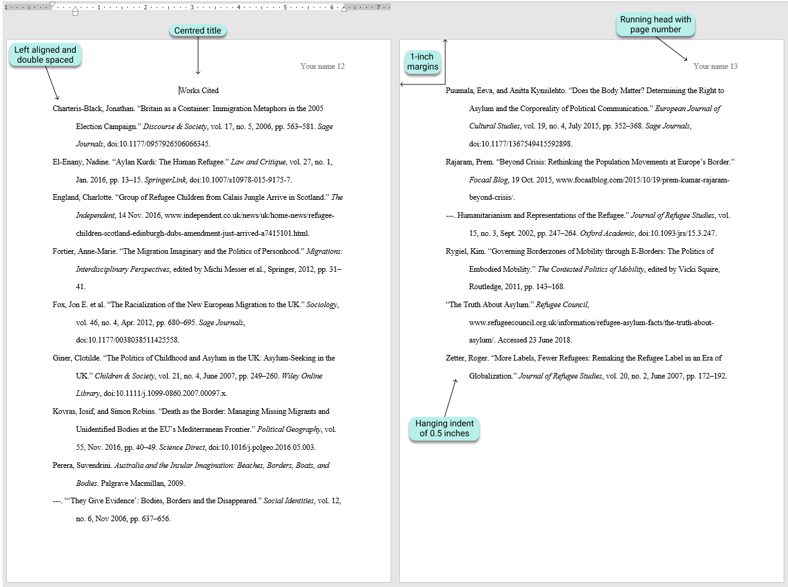
Notes:
Here’s an example of how the Works Cited list should be formatted.
The title is centered, and written in plain text.
The list is double-spaced, with 1-inch margins.
Entries are alphabetized by the author’s last name.
And a hanging indent is used: if an entry is more than one line long, each line after the first should be indented half an inch. A hanging indent can be created automatically in your word processor.

Slide 21
MLA format guidelines
Notes:
Although MLA mainly provide guidance on source citation, there are also some basic formatting guidelines to follow throughout your paper.
Scribbr offers free MLA format templates for Word and Google Docs, with the appropriate formatting already set up in the document.
“MLA format” article: https://www.scribbr.com/mla/formatting/
MLA format template for Word: https://cdn.scribbr.com/wp-content/uploads//2019/12/Scribbr-MLA-Format-Template.docx
MLA format template for Google Docs: https://docs.google.com/document/d/1at13MO3LBTcpNJ7QYrnk__tlGfxgRWOp1FiQgdk05qs/copy

Slide 22
Formatting a paper
Times New Roman 12
1” page margins
Double line spacing
½” indent for new paragraphs
Title case capitalization for headings
Notes:
These are the most important guidelines to follow when formatting your paper.
Use a simple and easy-to-read font and font size, like 12-point Times New Roman.
Set your page margins to 1 inch (this is usually the default anyway) and apply double line spacing throughout the text.
Each paragraph should start with an additional ½-inch indent.
Headings should use title case—that means you capitalize all the main words, but not shorter articles and prepositions like “the” and “of.”

Slide 23
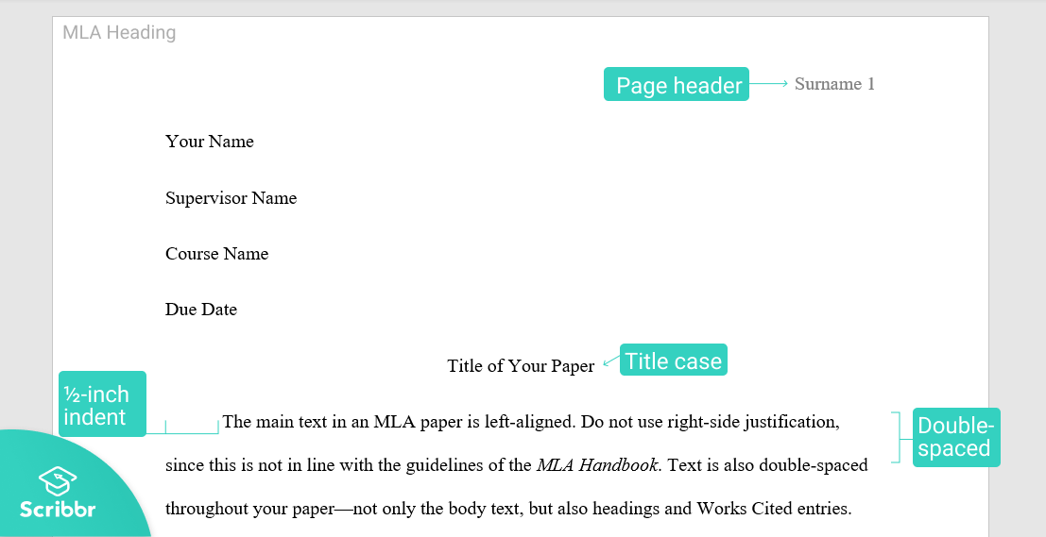
Notes:
Let’s look at some other key elements, as shown in this image.
The first thing in your paper is the heading; this is where you list your name, your supervisor’s name, the course the paper is for, and the due date.
These are written in plain text, left-aligned, at the start.
Next, the title of your paper appears, in title case and centered.
Additionally, every page of your paper should include a header in the top-right corner listing your surname and the page number. You can set this up using the “Header” feature in your word processor.
“MLA heading” article: https://www.scribbr.com/mla/heading/

Slide 24
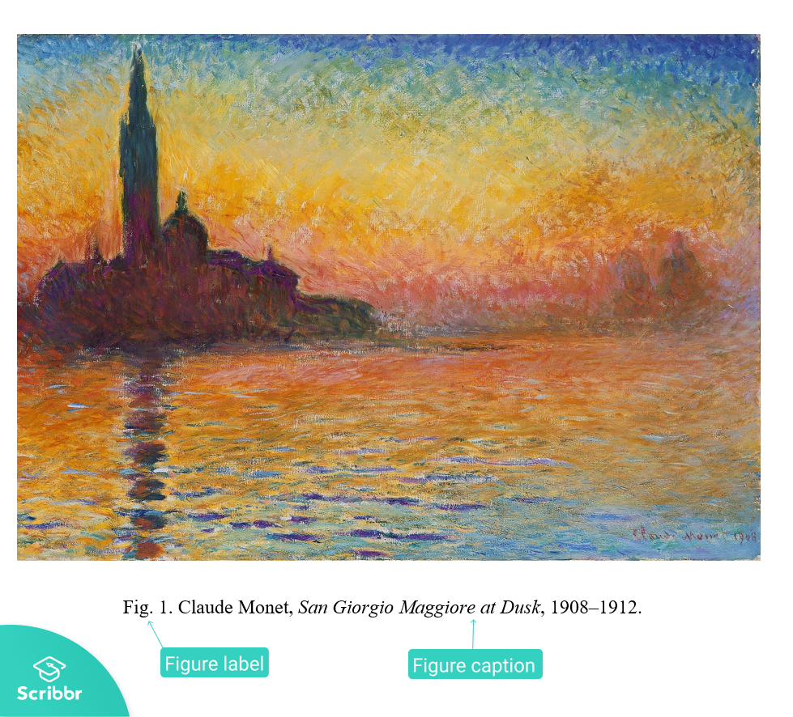
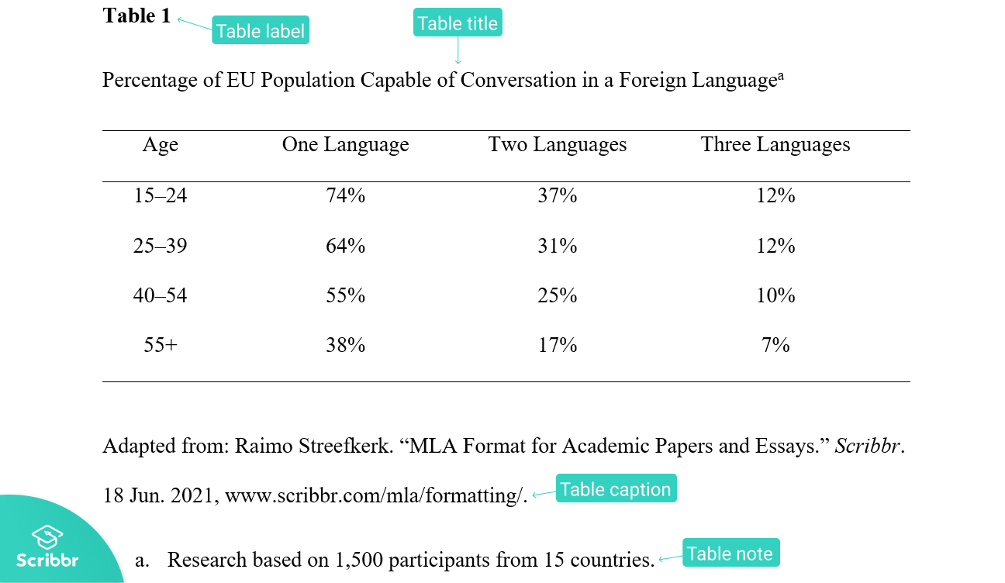
Tables and figures
Notes:
Here you can see how any tables and figures you include should be presented in MLA Style.
The table number appears above the table itself, with a descriptive title on the following line. A caption giving source information, along with any explanatory notes needed, appears below the table.
For figures (such as photographs, artworks, or infographics), the word “Figure” is abbreviated, and a descriptive caption follows on the same line, below the figure, and centered.
Each table or figure should be placed close to the paragraph in which you first refer to it.

Slide 25
Recommended resources

Slide 26

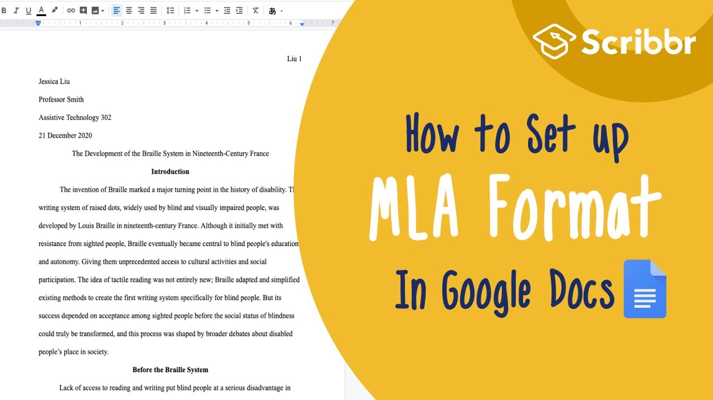
Scribbr resources
MLA resources
Free MLA Citation Generator
Knowledge Base (300+ articles)
YouTube Channel
Buy the MLA Handbook
Visit the MLA site
Notes:
As well as high-quality articles and videos, Scribbr also offers an MLA Citation Generator, where you can easily create your citations and manage your Works Cited list. It’s 100% free, with no ads and no sign-up required.

Slide 27
Hi, we’re Scribbr 👋
We are a team of 60 people in Amsterdam, and we partner with more than 500 freelance editors across the globe to help students graduate and become better academic writers.
Every day, we work hard on our Proofreading & Editing service, Plagiarism Checker, Citation Generator, Knowledge Base and educational YouTube channel.

Slide 28
Guidelines for using this presentation
This presentation can be freely used and modified for educational purposes. You may:
Display this presentation in a classroom environment
Modify or delete slides
Distribute this presentation in print or in private student environments (e.g. Moodle, BlackBoard, Google Classroom)
Please do give credit to Scribbr for creating this resource.
Questions or feedback? Email shona@scribbr.com and we’ll be in touch!
Notes:
How to edit this presentation:
Click on ‘File’ in the top-left corner.
Click on ‘Make a copy’
Select ‘Entire presentation’
Save the presentation in your personal Google Drive.
You can now edit the copy of this presentation!

