Slide 1
APA 7th Edition
The most notable changes
Notes:
These lecture slides are based on Scribbr’s Knowledge Base article APA Manual 7th edition: The most notable changes, which can be found here: https://www.scribbr.com/apa-style/apa-seventh-edition-changes/

Slide 2
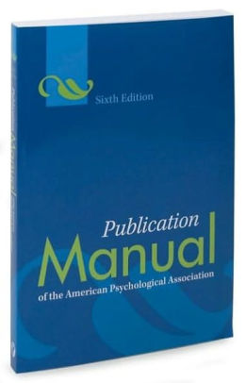
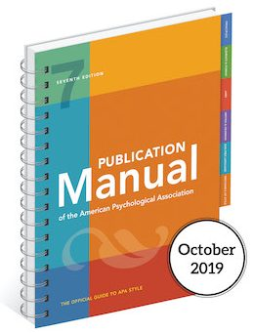
APA Publication Manual
6th edition
(2009)
7th edition
(October 2019)
Notes:
The 6th edition, published in 2009, has been around for 10 years.

Slide 3
What’s changed?
Better guidelines for citing online media
Updated guidelines for inclusive and bias-free language
Student-specific paper format
Minor changes in how to cite sources
Notes:
More examples and easier guidelines for citing online sources (e.g. social media, podcasts, YouTube videos).
Recommended usage of singular “they”.
Specific formatting guidelines for student papers (compared to academic papers), including a sample paper.
Small changes in how to cite sources.

Slide 4
References and in-text citations
7 notable changes
Notes:
When it comes to citing sources, more guidelines have been added that make citing online sources easier and clearer.
In total, 114 examples are provided, ranging from books and periodicals to audiovisuals and social media. For each reference category, an easy template is provided to help you understand and apply the citation guidelines.

Slide 5
Publisher location not included
Covey, S. R. (2013). The 7 habits of highly effective people: Powerful lessons in personal change. New York, NY: Simon & Schuster.
Covey, S. R. (2013). The 7 habits of highly effective people: Powerful lessons in personal change. Simon & Schuster.
Notes:
The publisher location is no longer included in the reference.
Many students had difficulties finding this information.

Slide 6
2. In-text citations are shortened
(Taylor, Kotler, Johnson, & Parker, 2018)
(Taylor et al., 2018)
Notes:
The in-text citation for works with three or more authors is now shortened right from the first citation. You only include the first author’s name and “et al.” (meaning “and others”).

Slide 7
3. Up to 20 authors in the reference list
Miller, T. C., Brown, M. J., Wilson, G. L., Evans, B. B., Kelly, R. S., Turner, S. T., … Nelson, T. P. (2018).
Miller, T. C., Brown, M. J., Wilson, G. L., Evans, B. B., Kelly, R. S., Turner, S. T., Lewis, F., Lee, L. H., Cox, G., Harris, H. L., Martin, P., Gonzalez, W. L., Hughes, W., Carter, D., Campbell, C., Baker, A. B., Flores, T., Gray, W. E., Green, G., … Nelson, T. P. (2018).
Notes:
Surnames and initials for up to 20 authors (instead of 7) should be provided in the reference list.
If a source is authored by more than 20 authors, only the first 19 authors and the last author are included. In between the 19th and last author you place an ellipses to indicate names are omitted.

Slide 8
4. DOIs are formatted as URLs
doi: 10.1080/02626667.2018.1560449
https://doi.org/10.1080/02626667.2018.1560449
Notes:
Most journal articles and books have a DOI (Digital Object Identifier) assigned to them. This unique link is stable (it doesn’t change over time) and makes retrieving a source easier for readers.
DOIs are formatted the same as URLs. The label “DOI:” is no longer used.

Slide 9
5. Citing web pages
Walker, A. (2019, November 14). Germany avoids recession but growth remains weak. Retrieved from https://www.bbc.com/news/business-50419127
Walker, A. (2019, November 14). Germany avoids recession but growth remains weak. BBC News. https://www.bbc.com/news/business-50419127
Notes:
URLs are no longer preceded by “Retrieved from,” unless a retrieval date is needed (e.g. for Wikipedia articles where content frequently changes).
The website name is included (unless it’s the same as the author).
Web page titles are italicized.

Slide 10
6. Citing ebooks
Brück, M. (2009). Women in early British and Irish astronomy: Stars and satellites [Kindle version]. doi: 10.1007/978-90-481-2473-2
Brück, M. (2009). Women in early British and Irish astronomy: Stars and satellites. Springer Nature. https:/doi.org/10.1007/978-90-481-2473-2
Notes:
For ebooks, the format, platform, or device (e.g. Kindle) is no longer included in the reference.
The publisher is included in the reference.
The DOI is formatted according to the new 7th edition guidelines.

Slide 11
7. Contributors other than authors
Media type | Include as author
Film | Director
TV series | Executive producer(s)
Podcast episode | Host of episode
Webinar | Instructor
Online streaming video | Person or group who uploaded the video
Photograph | Photographer
Notes:
Clear guidelines are provided for citing contributors other than authors and editors.
The contributors appear in the author position.
The role of the contributor is added in parentheses after their name, for example: Jones, P. D. (Director).

Slide 12
Inclusive and bias-free language
Updated guidelines
Notes:
Writing inclusively and without bias is the new standard, and APA’s new publication manual contains a separate chapter on this topic.
The guidelines provided by APA help authors reduce bias around topics such as gender, age, disability, racial and ethnic identity, and sexual orientation, as well as being sensitive to labels and describing individuals at the appropriate level of specificity.

Slide 13
Use singular “they”
A researcher’s career depends on how often he is cited.
A researcher’s career depends on how often they are cited.
Each examiner submitted his or her assessment.
Each examiner submitted their assessment.
Notes:
The singular “they” or “their” is endorsed as a gender-neutral pronoun. Avoid using “he or she” to refer to people of unspecified gender.

Slide 14
Be sensitive to labels
The poor
People living in poverty
Transsexuals
Transgender people
Notes:
Instead of using adjectives as nouns to label groups of people, descriptive phrases are generally preferred. Respect the language that people use to describe themselves and be aware that language changes over time.

Slide 15
Appropriate level of specificity
Over-65s
People aged 65 to 75
Asian participants
Vietnamese, Cambodian, and Thai participants
Notes:
When possible, give specific characteristics rather than broad categories. The appropriate choice depends on context.

Slide 16
Paper format
Student-specific guidelines
Notes:
In the 7th edition, APA decided to provide separate format guidelines for professional and student papers. For both types a sample paper is included. Some notable changes for student papers follow in the next three slides.

Slide 17
More fonts to choose from
Times New Roman (12 pt)
Arial (11pt)
Georgia (11pt)
Calibri (11pt)
Lucida Sans Unicode (10pt)
Notes:
In the 6th edition, only the use of Times New Roman was recommended. In the 7th edition there is more flexibility regarding fonts.
The most important things is that the font should be easy to read for everyone.

Slide 18
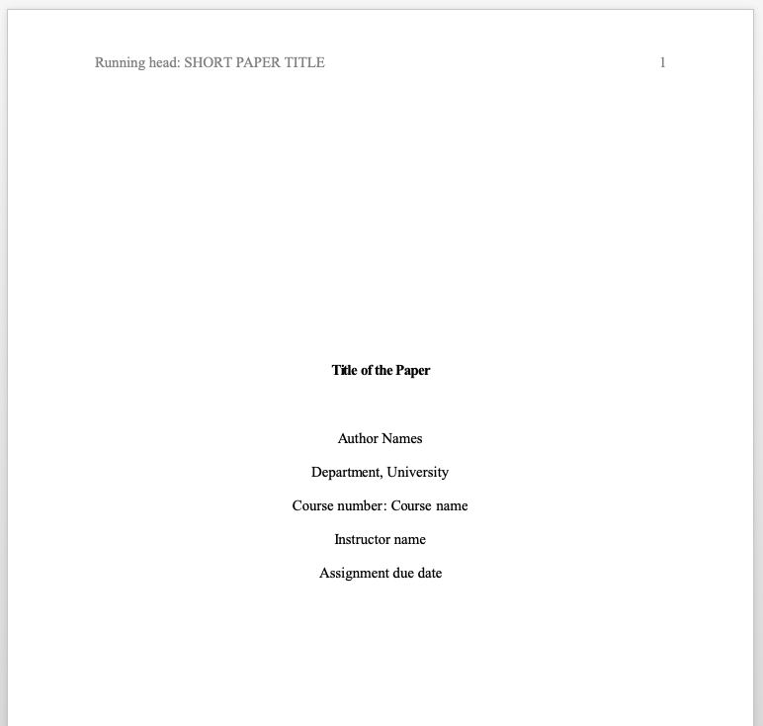

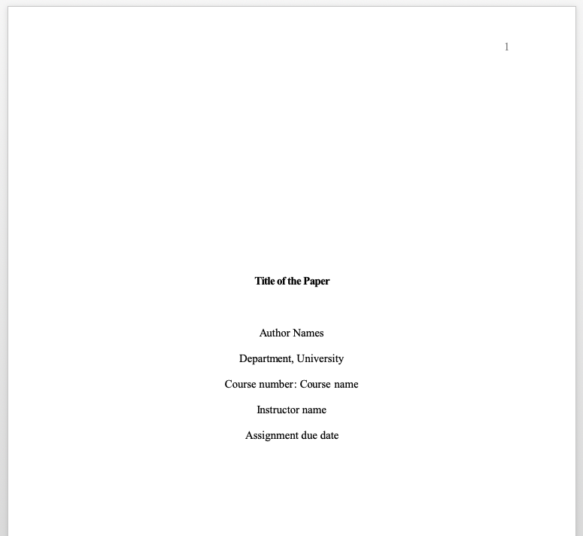

No more running head
Notes:
In student papers, a running head (stating the paper title at the top of every page) is no longer required.

Slide 19
Updated heading styles
Level | Format
1 | Centered, Bold, Title Case
2 | Left-aligned, Bold, Title Case
3 | Left-aligned, Bold, Italic, Title Case
4 | Indented, Bold, Title Case, Period. Text begin on the same line.
5 | Indented, Bold, Italic, Title Case, Period. Text begin on the same line.
Notes:
Heading levels 3, 4, and 5 are updated to improve readability.
All headings are now bold and title case.

Slide 20
Recommended resources

Slide 21
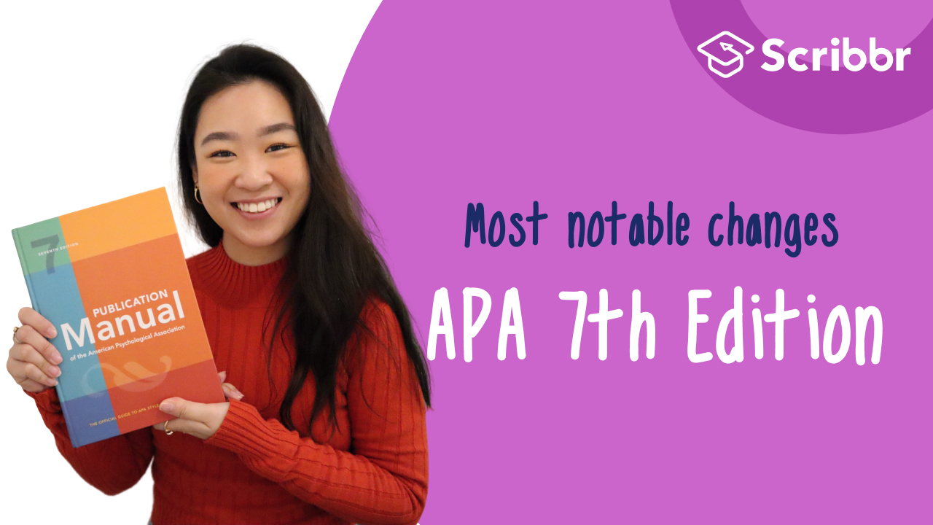
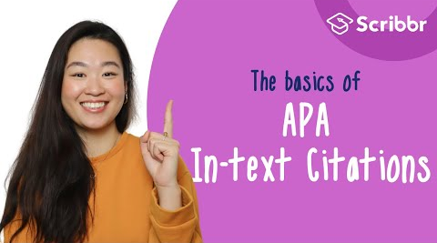

Scribbr resources
Knowledge Base (300+ articles)
Free APA Citation Generator
YouTube Channel
Notes:
Scribbr provides high-quality articles and videos for free. Every month over 2 million students make use of these resources.

Slide 22
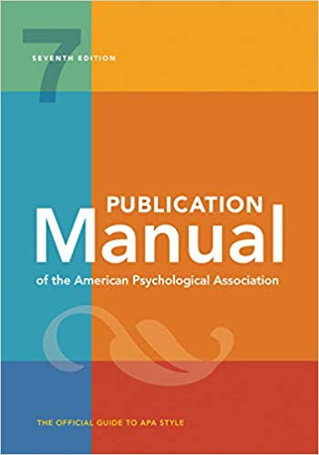
APA Publication Manual
Student’s guide ($31.99)
Hardcover ($54.99)
Paperback ($31.99)
Spiral-bound (with tabs) ($44.99)
Ebook ($35.99)
Notes:
The new APA Publication Manual (7th edition) is available in various versions, from ebook to hardcover. In addition, APA published a concise student version, available on Amazon.

Slide 23
Hi, we’re Scribbr 👋
We are a team of 60 young people in Amsterdam, and we partner with more than 500 freelance editors across the globe to help students graduate and become better academic writers.
Every day, we work hard on our Proofreading & Editing service, Plagiarism Checker, Citation Generator, Knowledge Base and educational YouTube channel.

Slide 24
Guidelines for using this presentation
This presentation can be freely used to educate students about the 7th edition changes in the APA Publication Manual. You may:
Display this presentation in a classroom environment
Modify or delete slides
Distribute this presentation in print or in private student environments (e.g. Moodle, BlackBoard, Google Classroom, etc.)
Please do give credit to Scribbr for creating this resource.
Questions of feedback? Email raimo@scribbr.com and we’ll be in touch!

